Slide 1

California: The Golden State Departure
Group four project 2
January 6, 2021

Slide 2
Group Four Team Members
Stuart Hunter
Shahrzad Khoobyari
Michelle Taymuree
Victor Tran
Pooja Verma

Slide 3
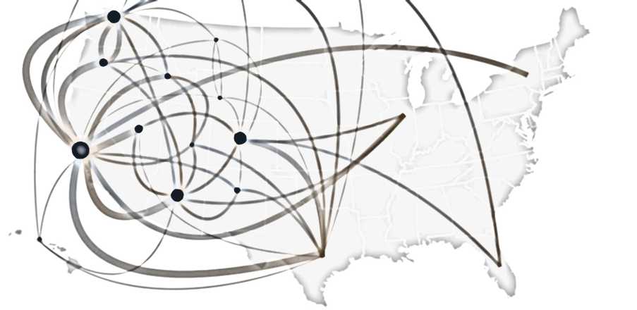
Migration Out of California?
Are people leaving California?
Which states are people moving to?
What factors are leading to this migration?
Cost of Living
Career Opportunities
Retirement

Slide 4
Data Analysis: The Tools
Data Collection | Initial DATA Analysis | Data Storage | Dashboard/ website
Census.gov | Jupyter Notebook | Mongo DB: 2 collections | Python Flask to HTML page
Jupyter Notebook | Python/Pandas | Collection #1: General census info from states | JSON files created from MongoDB
API Requests to extract data | Data formatted, explored, cleaned and analyzed | Collection #2: Migration flow from CA | Plotly charts created from JSON files

Slide 5
Live Website Demonstration

Slide 6
Conclusions
In the last 10 years
Increasing number of people are retiring outside of CA
Young couples with children are not leaving CA
Data from the past 2 years suggests young couples are moving into CA
Increasing number of people 150% above the poverty line are moving out of CA
Increasing number of people with a college degree or higher level of education are moving out of CA
Equal movement in men and women
Poverty and unemployment rates are dropping in CA

Slide 7
Questions?

Slide 8
Appendix

Slide 9
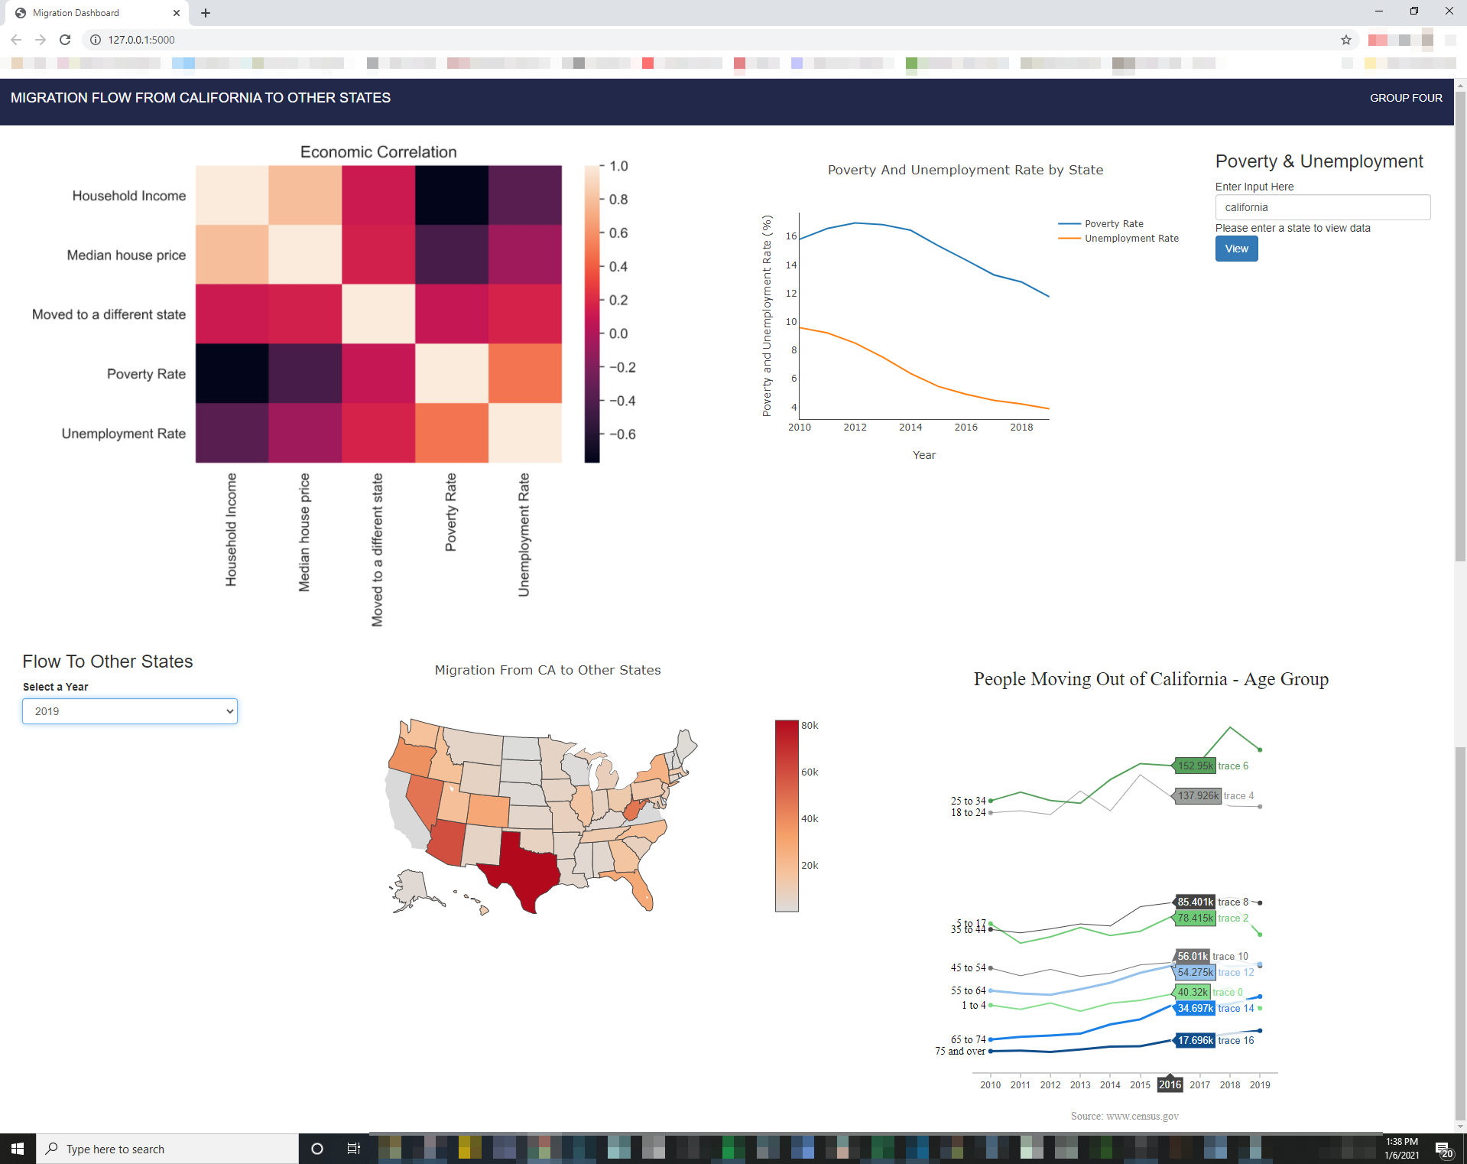
Website Screenshot

Slide 10
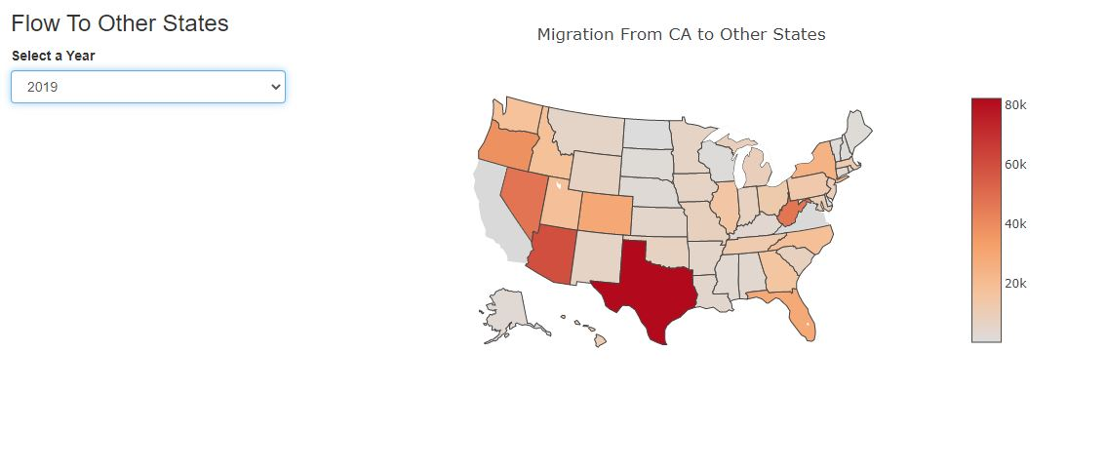
Website Screenshot: The Map

Slide 11
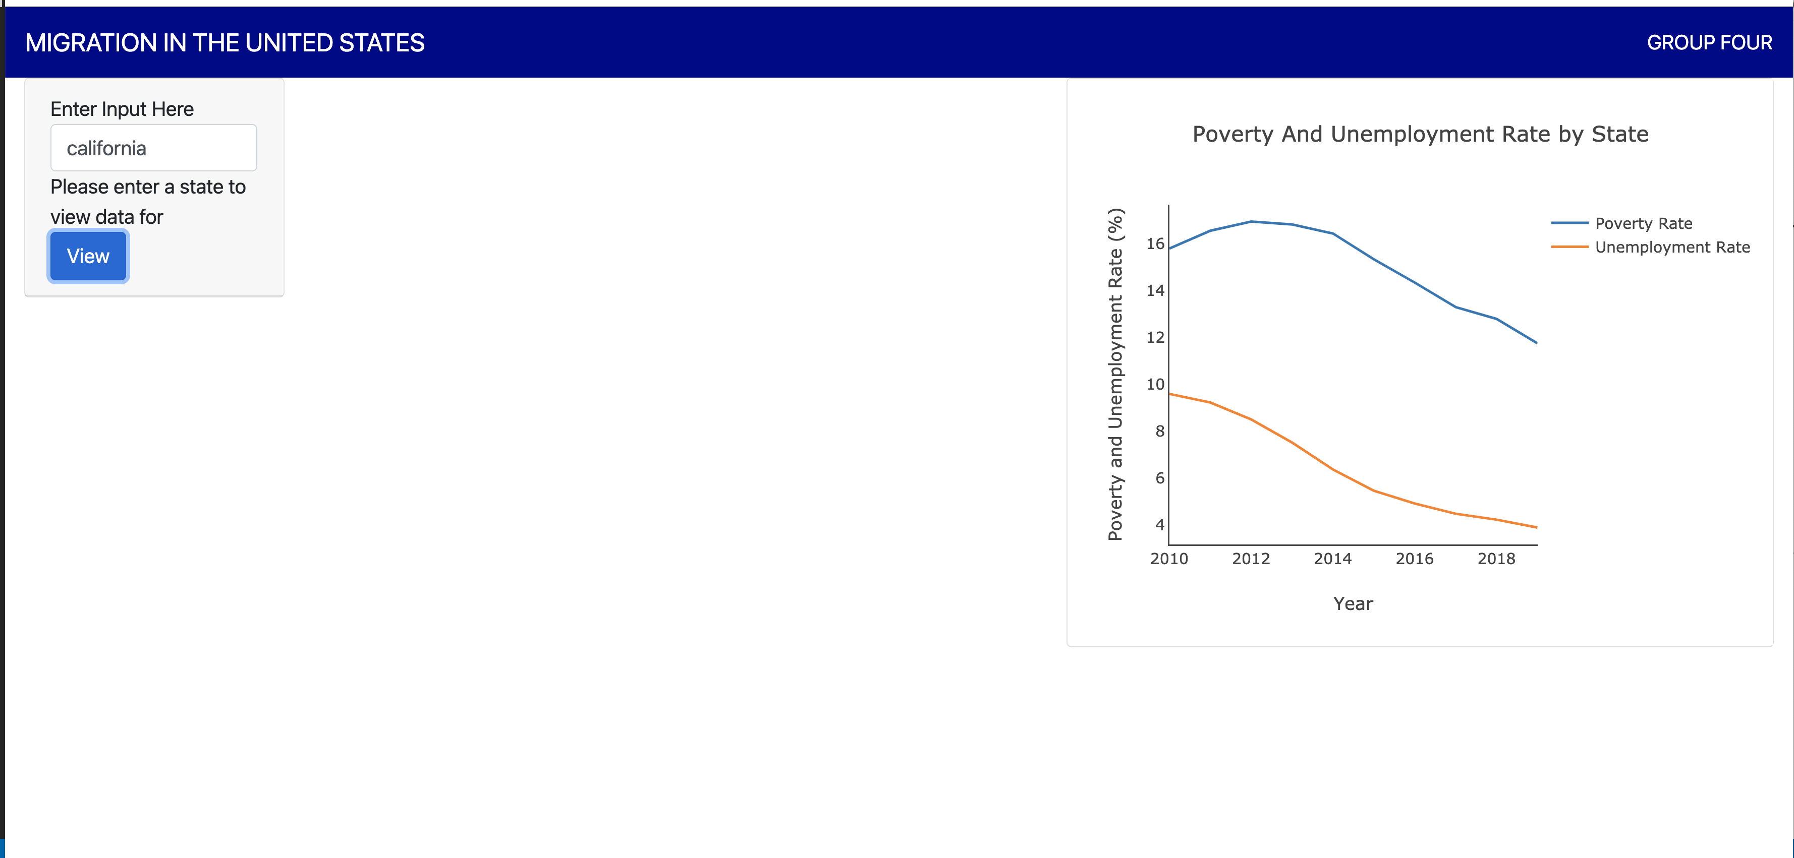
Website Screenshot: The Map

